Slide 1
Parent Group Tickets
Introduction
Parent group tickets are those which are not assigned to anyone. We are having parent tickets for:
Incidents
Requests/RITM’s
All Parent Tickets can be found in the below URL: https://wabtec.sharepoint.com/sites/DnAOperations/SitePages/Ticket-Mo.aspx

Slide 2
Purpose:
How to monitor parent group tickets and whom we need to contact on any parent ticket.
Instruction
Steps to monitor Parent tickets:
Step1: Open below URL
https://wabtec.sharepoint.com/sites/DnAOperations/SitePages/Ticket-Mo.aspx

Slide 3
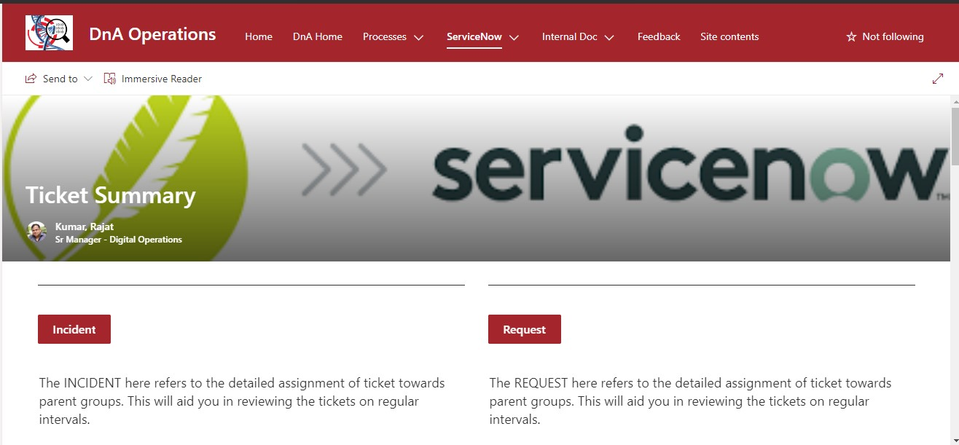
Step2: Choose type of ticket
As we can see Incident and Request button, click on any button based on requirement.

Slide 4
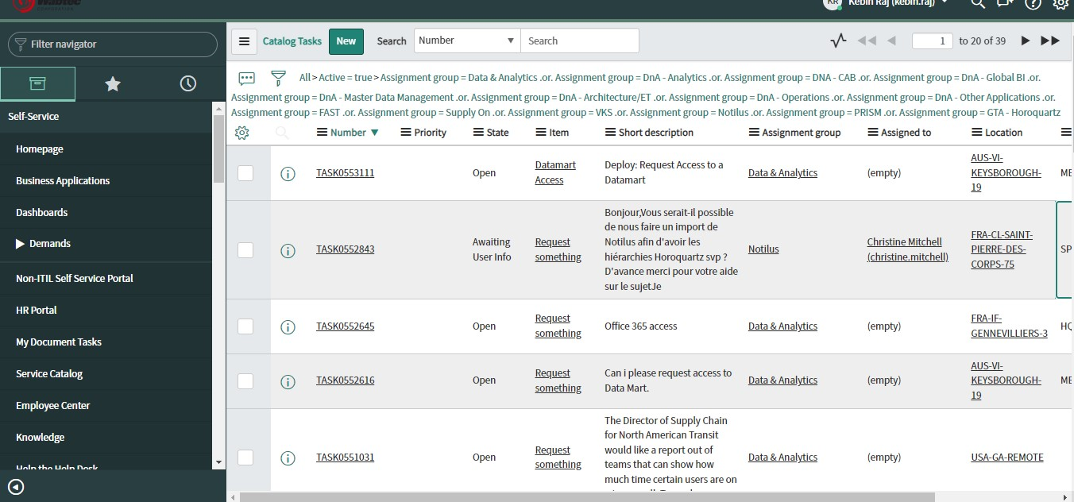
Step3: Monitoring tickets
Once you have opened Incident/Request all the open tickets can be viewed. Make sure that Assigned to column is not empty for any ticket.
If you find any empty data for Assigned to column, open the ticket and check the Assignment Group for that particular ticket.

Slide 5
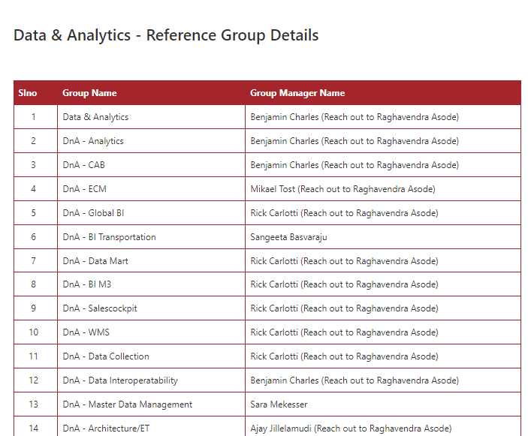
Step4: Person to Contact
In the above-mentioned URL, by scrolling down the page you can find a table which displays the data of all Group names and Group Manager names to contact.

Slide 6
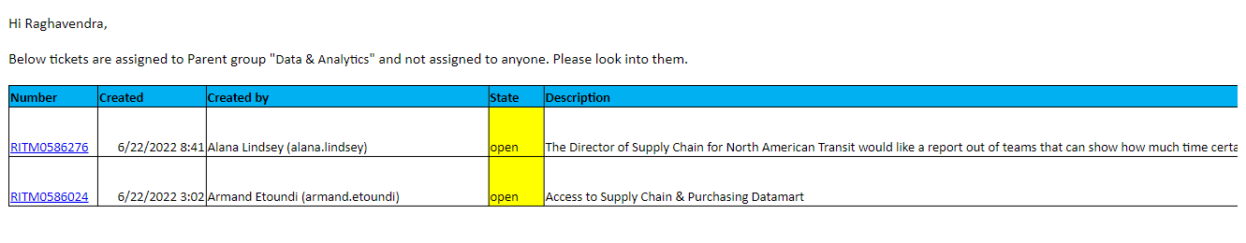
Check the relevant Assignment Group and you can find that person to
Mail/Contact for that particular ticket.
Once you find the manger to contact, drop a mail by mentioning all the
details regarding that ticket and its status.
Example as given below:

